Slide 1
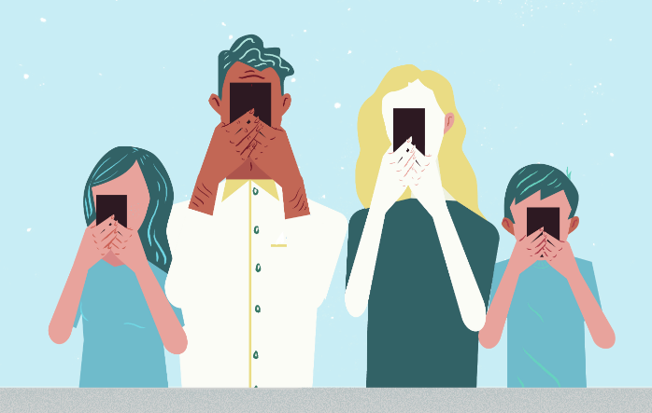
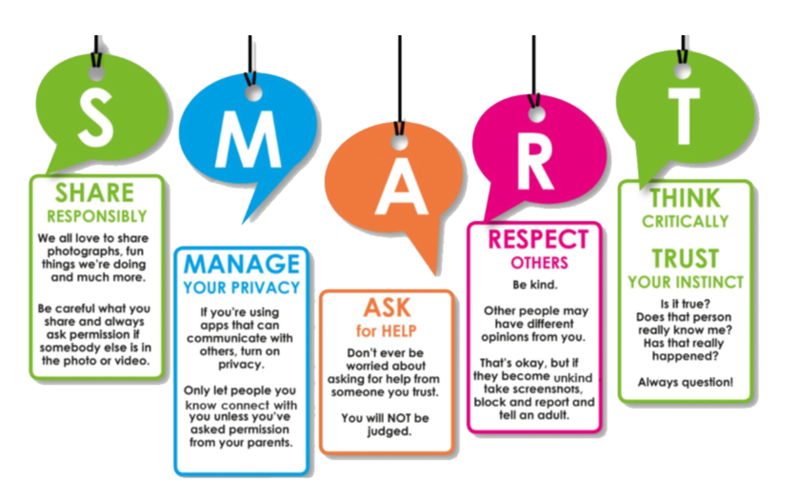
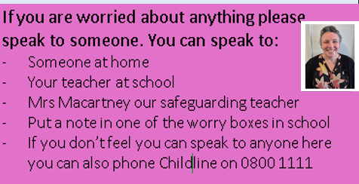
Year 5: Relationships
Subject Specific Vocabulary
self esteem | how confident we feel about ourselves
safe | Safe means being protected from harm or danger.
unsafe | Unsafe means being at risk of getting hurt or in danger.
Rights and responsibilities. | Rights are things you're allowed to do; responsibilities are duties.
mental health | emotional and social wellbeing, including how we think, feel and act
gaming | Gaming is playing video games for fun or challenge.
Questions for family learning
How do you know if people you talk to online are really who they say they are? What would you do if you heard or saw something online which made you feel uncomfortable? How much screen time do you think you have every day?
Sticky Knowledge
Age restrictions are in place so that people are mature enough to do the things at a certain age.
THINK before I do anything on the internet to ensure it is safe and helpful for us and others.
Be SMART online

